Slide 1


Slide 2
P4 E-Commerce BA - Customer & Purchase Analytics for Enhanced Business Growth
A Capstone Project for Associate Data Analysts
Presented by: Tang Seong Fatt
Date: June 1, 2025
Course/Project: Capstone Project - Data Analysis Training
Notes:
Good morning/afternoon, everyone, and welcome. Today, I'm excited to present my capstone project on E-commerce Business Analytics. This project has been a crucial step in my journey as a data analyst, allowing me to integrate and apply the knowledge and skills gained throughout my academic journey to a real-life business problem. It specifically aimed to demonstrate my understanding of key concepts, methodologies, and best practices in data analysis that we've covered in our training.
This project also served as a valuable opportunity for professional development, fostering critical skills such as time management, teamwork, and problem-solving, all while working with real-world e-commerce data.

Slide 3
Agenda
Objective of the Project
Data Information & Overview
General Process: Problem Statement, Research Objective, Data Understanding & Preparation, Report Creation, Conclusion
Key Findings & Insights
Recommendations
Future Scope
Q&A
Notes:
Here's a quick look at what we'll cover today. We'll start by outlining the project's objective, then dive into the dataset itself. I'll walk you through the entire data analysis process, from initial understanding to the final report creation. We'll then explore the key findings and insights derived from the data, followed by actionable recommendations and a look at future opportunities for analysis. Finally, we'll open the floor for any questions.

Slide 4
Project Objective
Integrate & apply data analysis knowledge and skills.
Demonstrate understanding of methodologies & best practices.
Foster professional development (time management, teamwork, problem-solving).
Notes:
The core objective of this project was to integrate and apply the knowledge and skills gained throughout my academic journey to a real-life business problem. This project wasn't just about applying formulas; it was about understanding the business problem first, then translating that into actionable data analysis. It really solidified how the different modules of our training connect to solve real-world challenges.
It aimed to demonstrate my understanding of key concepts, methodologies, and best practices in data analysis. One key takeaway was the importance of starting with a clear objective, as it guided every decision, from data preparation to visualization.
This project also served as a valuable opportunity for professional development, fostering critical skills such as time management, teamwork, and problem-solving.

Slide 5
Business Problem Statement
Company aims to create a robust customer base.
Enhance overall customer experience.
Recommend relevant products.
Ultimately increase revenue based on available data.
Notes:
Our assumed business problem statement is that the company is looking to create a robust customer base, enhance the overall customer experience, recommend relevant products, and ultimately increase revenue, all based on the available data.

Slide 6
Research Objective
Generate a comprehensive report to understand customers.
Explore dataset thoroughly.
Develop practical and insightful solutions.
Notes:
To address this problem, my primary research objective was to generate a comprehensive report. This report aims to provide crucial insights that will help the company better understand their customers.
I was encouraged to explore the dataset thoroughly and develop solutions based on my understanding, ensuring a practical and insightful approach.

Slide 7
Data Information Overview
Dataset is a subset from a Shopee, Brazil project.
Certain columns removed for privacy.
Contains necessary details: orders, customer demographics, products, segments, quantity, shipping costs.
All features described in Data_Dictionary.pdf.
Notes:
The dataset provided for this project is a subset of data from a Shopee, Brazil project. Please note that certain columns were removed to adhere to privacy policies.
Despite these modifications, the data contains all necessary details regarding orders, customer demographics, products, segment information, quantity, and shipping costs.
All features are meticulously described in the Data_Dictionary.pdf, which was my first point of reference for understanding the raw data.

Slide 8
Data Understanding & Preparation - The Foundation
Grasping features & relationships.
Transforming raw data into clean, usable format.
Crucial tasks: imputing missing values, correcting data types, deriving new custom columns.
Notes:
The first critical step in any data analysis is understanding and preparing the data. This involves grasping the features within the dataset and the relationships between variables, which then informs how we prepare the data for analysis.
This phase truly reinforced the saying, 'Garbage in, garbage out.' I learned that even with seemingly clean data, thorough inspection is critical to prevent errors from propagating through the analysis.
Data preparation is paramount. It involves transforming raw data into a clean, usable format. This includes crucial tasks such as imputing missing values, correcting data types, and deriving new custom columns to enhance analytical capabilities. It was also an excellent opportunity to practice identifying potential data quality issues and thinking strategically about how to address them before moving forward.

Slide 9
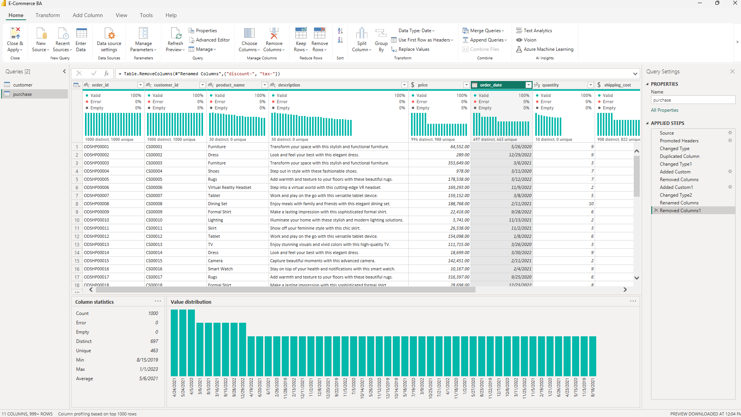
Data Cleaning Process in Detail
Loading & Initial Inspection (customer.csv, purchase.csv).
Handling Missing Values (No significant missing values identified).
Data Type Correction (order_date, shipping_date, numerical columns).
Column Renaming (customer_product_name to product_name).
Duplicate Removal (based on customer_id, order_id).
Addressing Inconsistencies (e.g., 'RenÃ©' to 'René').
Regional date to be Brazil
Notes:
My data cleaning process involved several key steps: First, I loaded customer.csv and purchase.csv and performed an initial visual inspection of data types and column headers.
Fortunately, no significant missing values were identified, ensuring data completeness.
I focused on **Data Type Correction**, ensuring order_date and shipping_date were correctly formatted as dates, and all numerical columns like price, quantity, tax, discount, shipping_cost, age, and income were set to appropriate numerical types. This ensures accurate calculations.
For consistency, I renamed customer_product_name to product_name in the Purchase table. Duplicate removal was also crucial; I verified and removed any duplicate entries based on customer_id and order_id to ensure data integrity, which is a foundational principle we covered in our data management modules.
Finally, I addressed minor inconsistencies, like correcting 'RenÃ©' to 'René' in the customer dataset, ensuring the data was as clean and consistent as possible for analysis.

Slide 10
Feature Engineering with DAX
Created new calculated columns & measures for deeper insights.
• Key DAX Measures & Columns:
• Total Price = Purchase[price] * Purchase[quantity]
• Discount Amount = Purchase[Total Price] * Purchase[discount]
• Tax Amount = Purchase[Total Price] * Purchase[tax]
• Net Revenue (per item) = Purchase[Total Price] - Purchase[Discount Amount] + Purchase[Tax Amount] + Purchase[shipping_cost]
• Order Year = YEAR('Purchase'[order_date])
• Order Month = FORMAT('Purchase'[order_date], "MMM")
• Delivery Days = DATEDIFF('Purchase'[order_date], 'Purchase'[shipping_date], DAY)
• Age Group and Income Level (for customer segmentation).
• Product Category (derived from product_name using SWITCH(TRUE(), CONTAINSSTRING())).
• Total Revenue = SUM(Purchase[Net Revenue])
• Total Orders = DISTINCTCOUNT(Purchase[order_id])
• Total Customers = DISTINCTCOUNT(Customer[customer_id])
• Average Order Value = DIVIDE([Total Revenue], [Total Orders], 0)
• Total Quantity Sold = SUM(Purchase[quantity])
• Number of Repeat Customers
• Average Orders Per Customer
Notes:
To derive deeper insights and enable more powerful analysis, I created several new calculated columns and measures using DAX (Data Analysis Expressions).
Feature engineering with DAX was a powerful learning experience. It showed me how to transform raw data into meaningful metrics that directly address business questions, like **Net Revenue** which gives us the true profit per item, and **Delivery Days** for operational efficiency.
Creating columns like **Age Group**, **Income Level**, and **Product Category** allowed me to go beyond simple numbers and segment our data in ways that are much more useful for targeted analysis and recommendations. For Product Category, I used the SWITCH(TRUE(), CONTAINSSTRING()) method to intelligently group diverse product names into broader, actionable categories based on keywords.
I learned that choosing the right DAX function and understanding context was key to efficiently and accurately deriving these new insights, such as **Total Revenue**, **Total Orders**, **Total Customers**, and **Average Order Value**, which are fundamental KPIs for any e-commerce business. These calculations allow us to look beyond raw data and understand true financial impact and operational efficiency.

Slide 11
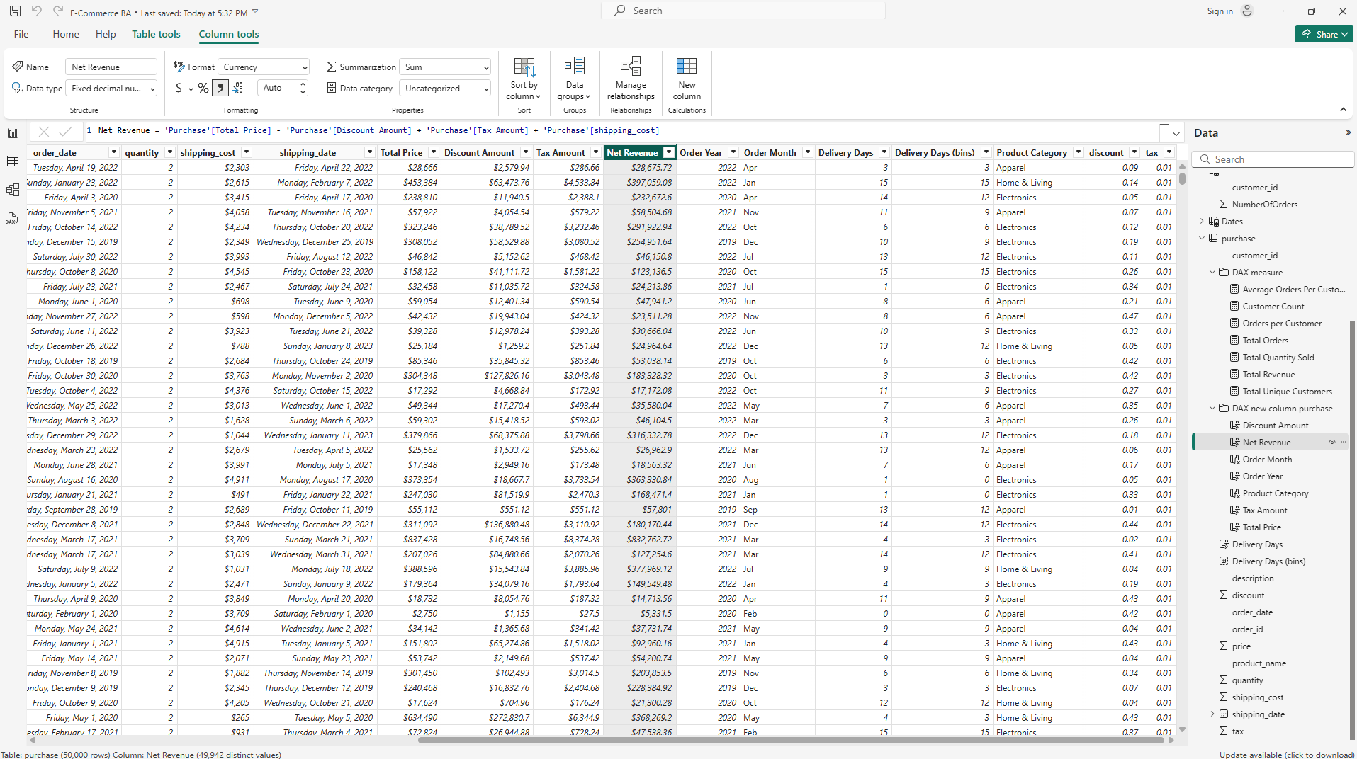
Feature Engineering with DAX
Created new calculated columns & measures for deeper insights.
• Key DAX Measures & Columns:
• Total Price = Purchase[price] * Purchase[quantity]
• Discount Amount = Purchase[Total Price] * Purchase[discount]
• Tax Amount = Purchase[Total Price] * Purchase[tax]
• Net Revenue (per item) = Purchase[Total Price] - Purchase[Discount Amount] + Purchase[Tax Amount] + Purchase[shipping_cost]
• Order Year = YEAR('Purchase'[order_date])
• Order Month = FORMAT('Purchase'[order_date], "MMM")
• Delivery Days = DATEDIFF('Purchase'[order_date], 'Purchase'[shipping_date], DAY)
• Age Group and Income Level (for customer segmentation).
• Product Category (derived from product_name using SWITCH(TRUE(), CONTAINSSTRING())).
• Total Revenue = SUM(Purchase[Net Revenue])
• Total Orders = DISTINCTCOUNT(Purchase[order_id])
• Total Customers = DISTINCTCOUNT(Customer[customer_id])
• Average Order Value = DIVIDE([Total Revenue], [Total Orders], 0)
• Total Quantity Sold = SUM(Purchase[quantity])
• Number of Repeat Customers
• Average Orders Per Customer
Notes:
To derive deeper insights and enable more powerful analysis, I created several new calculated columns and measures using DAX (Data Analysis Expressions).
Feature engineering with DAX was a powerful learning experience. It showed me how to transform raw data into meaningful metrics that directly address business questions, like **Net Revenue** which gives us the true profit per item, and **Delivery Days** for operational efficiency.
Creating columns like **Age Group**, **Income Level**, and **Product Category** allowed me to go beyond simple numbers and segment our data in ways that are much more useful for targeted analysis and recommendations. For Product Category, I used the SWITCH(TRUE(), CONTAINSSTRING()) method to intelligently group diverse product names into broader, actionable categories based on keywords.
I learned that choosing the right DAX function and understanding context was key to efficiently and accurately deriving these new insights, such as **Total Revenue**, **Total Orders**, **Total Customers**, and **Average Order Value**, which are fundamental KPIs for any e-commerce business. These calculations allow us to look beyond raw data and understand true financial impact and operational efficiency.

Slide 12
Report Creation & Key Performance Indicators (KPIs)
• Created professional report with clear client findings.
• Included important KPIs for actionable information.
• Focused on intuitive and informative Power BI dashboards.
Notes:
Once the data was thoroughly prepared and enhanced, the next step was to create a professional report, ensuring all key findings are clear to the client.
My report includes important KPIs, which are crucial for deriving actionable information and making informed business decisions. Designing these KPIs really brought home the importance of telling a story with data. It's not just about showing numbers, but about making them actionable and easy to understand for stakeholders.
I focused on building intuitive and informative dashboards in Power BI to visualize these KPIs and trends, recognizing that even the best analysis won't be impactful if it's not communicated effectively.

Slide 13
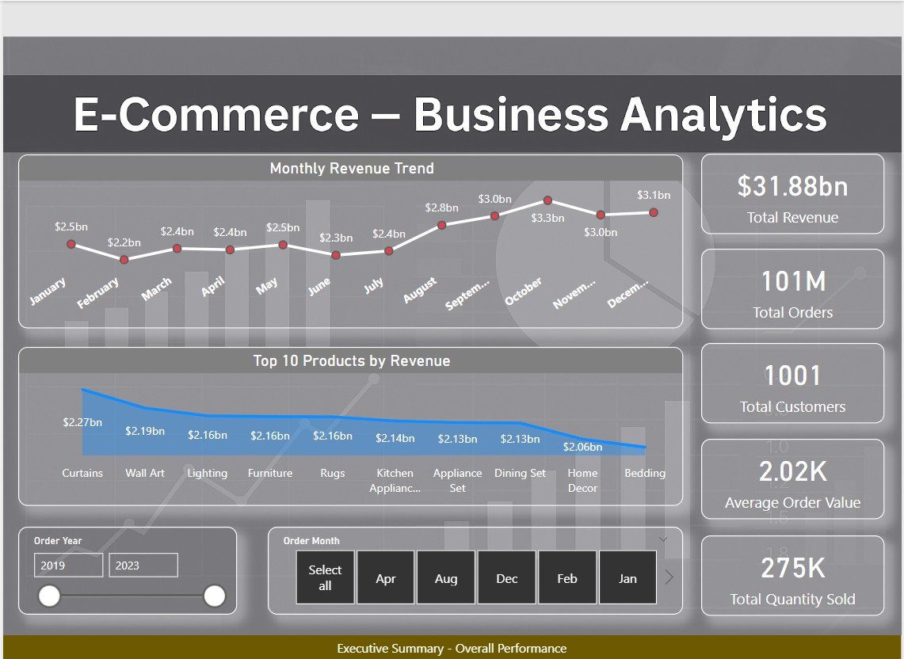
Dashboard 1: Executive Summary - Overall Performance
• High-level overview of e-commerce performance.
• Insights into: Total Revenue, Total Orders, Total Customers, Average Order Value, Total Quantity Sold.
• Monthly revenue trend for seasonal patterns & growth.
Notes:
This dashboard provides a high-level overview of our e-commerce performance. As you can see, we have immediate insights into total revenue, total orders, total customers, average order value, and total quantity sold – these are the foundational metrics for any e-commerce business.
The monthly revenue trend helps us identify seasonal patterns and overall growth trajectory, indicating when peak sales occur and if our business is consistently growing.

Slide 14
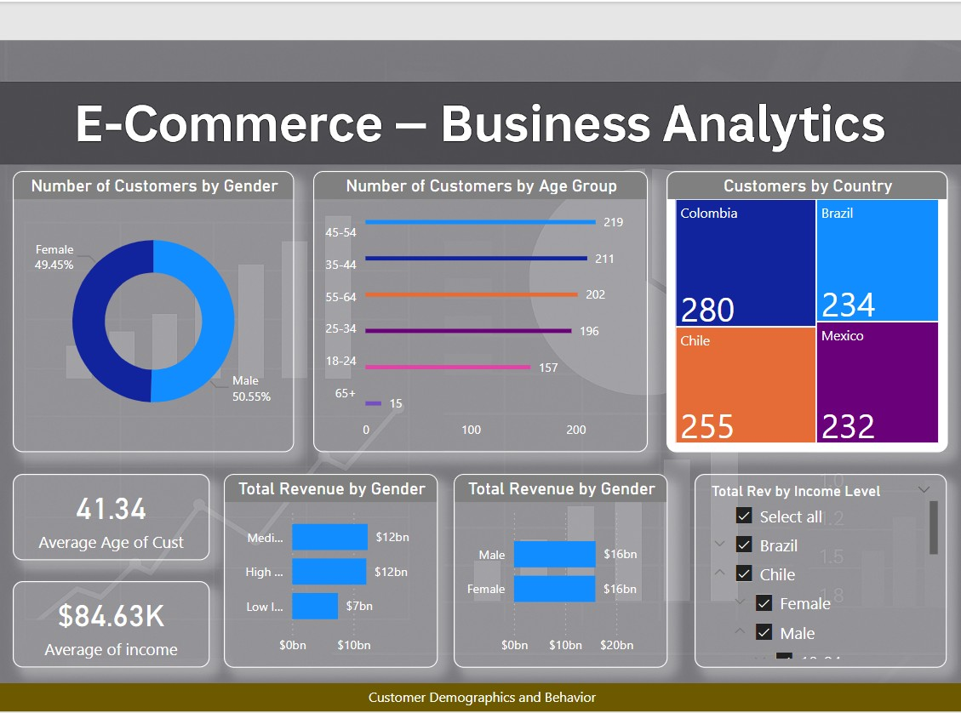
Dashboard 2: Customer Demographics and Behavior
• Understanding the customer base is paramount.
• Distribution by: gender, age groups, countries of origin.
• Contribution of segments to overall revenue.
Notes:
Understanding our customer base is paramount. This dashboard delves into customer demographics and their purchasing behaviors. We can see the distribution of customers by gender, age groups, and their countries of origin, along with how these segments contribute to overall revenue. This allows us to tailor marketing efforts and product development to specific customer segments.

Slide 15
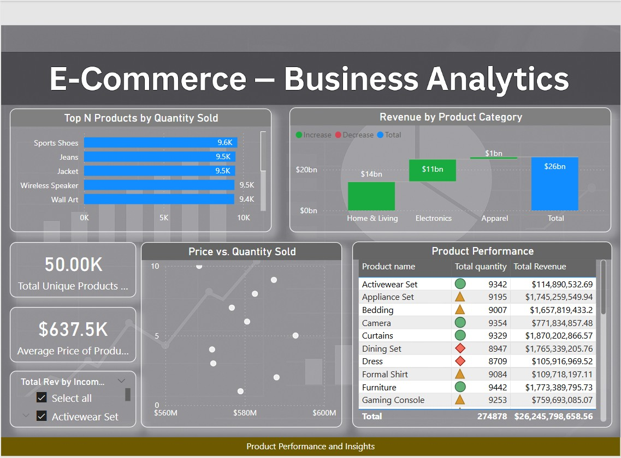
Dashboard 3: Product Performance and Insights
• Optimize product offerings & marketing strategies.
• Highlights: Top-selling products by quantity & revenue.
• Identifies products performing well or needing attention.
Notes:
To optimize product offerings and marketing strategies, this dashboard focuses on product performance. It highlights our top-selling products by quantity and revenue, helping us to identify products that are performing exceptionally well and those that may need attention or a revised strategy. This directly informs inventory management and promotional campaigns.

Slide 16
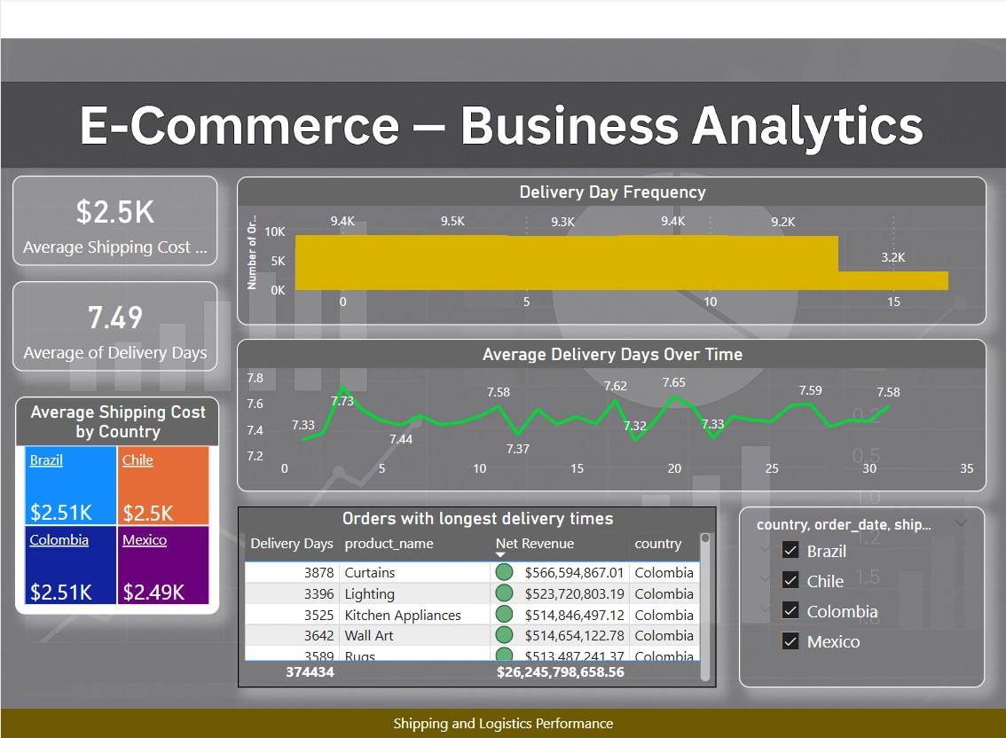
Dashboard 4: Shipping and Logistics Performance
• Efficient logistics key to customer satisfaction.
• Insights into: average shipping costs, delivery times.
• Helps optimize supply chain & improve customer experience.
Notes:
Efficient logistics are key to customer satisfaction and operational costs. This dashboard provides insights into our shipping performance, including average shipping costs and delivery times. This information can help optimize our supply chain, identify bottlenecks, and ultimately improve the customer experience by ensuring timely and cost-effective deliveries.

Slide 17
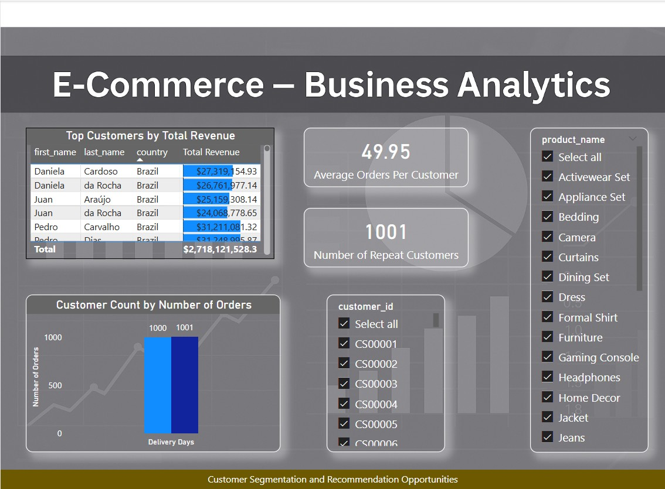
Dashboard 5: Customer Segmentation and Recommendation Opportunities
• Identify customer segments for targeted marketing.
• Analyze customer order frequency & total revenue.
• Identify valuable customers & tailor recommendations.
Notes:
Finally, this dashboard aims to identify different customer segments and opportunities for product recommendations. By analyzing customer order frequency and their total revenue, we can identify our most valuable customers – like our repeat buyers and high-spending clients – and tailor marketing efforts and product recommendations specifically for them, fostering loyalty and increasing lifetime value.

Slide 18
Conclusion & Key Insights
• Majority customers within [Age Group] and [Income Level] segments (target audience).
• Product X consistently drives highest revenue (focus promotion).
• Noticeable increase in delivery days during [specific period] (investigate logistics).
Notes:
In conclusion, our data analysis revealed several important insights. Beyond just presenting the findings, this project taught me the importance of the 'so what' – what do these insights actually mean for the business?
For example, we found that the majority of our customers fall within the [mention specific Age Group] and [mention specific Income Level] segments. This clearly indicates our primary target audience, suggesting specific marketing campaigns can be highly effective.
Another key insight was that [mention a specific product or category] consistently drives the highest revenue, suggesting a clear area of strength for us to focus on promotion and inventory management.
Furthermore, we observed a noticeable increase in delivery days during [mention specific period, e.g., holiday season or specific month], which highlights an area where logistics might need investigation to improve customer satisfaction during those times.

Slide 19
Recommendations
• Develop targeted marketing campaigns for [Age Group] segment promoting frequently purchased products.
• Investigate supply chain optimizations for [Product X] to ensure consistent availability & reduce shipping costs.
• Implement loyalty program for high-income customers to foster repeat purchases.
Notes:
Based on these insights, I recommend the following actionable steps: First, we should develop targeted marketing campaigns specifically for our identified [Age Group] segment, promoting the types of products they frequently purchase. This directly ties back to customer segmentation learnings.
Second, based on the strong performance of [mention Product X], I recommend investigating supply chain optimizations for this product to ensure its consistent availability and potentially reduce shipping costs, further boosting its profitability.
And third, to foster loyalty and increase lifetime value, I suggest implementing a tailored loyalty program for our high-income customers, recognizing their significant contribution to revenue.
Developing these recommendations showed me how to translate analytical findings into practical, actionable steps for business teams.

Slide 20
Future Scope
• Conduct deeper market basket analysis for product bundling opportunities.
• Implement predictive analytics to forecast demand for specific products.
• Integrate customer feedback data for enhanced customer experience.
• Explore geo-spatial analysis for optimizing shipping routes & inventory.
Notes:
Looking ahead, there are several exciting areas for further analysis and improvement. This section allows me to show that I understand that data analysis is an iterative process. While we achieved significant insights, there's always potential for deeper exploration and more advanced techniques.
This includes conducting a deeper market basket analysis to identify optimal product bundling opportunities, which could drive larger average order values.
Implementing predictive analytics to forecast demand for specific products would allow for more proactive inventory management.
Further integrating customer feedback data could provide qualitative insights to enhance customer experience initiatives.
And finally, exploring geo-spatial analysis of customer locations could help optimize shipping routes and inventory placement, reducing logistics costs.
Thinking about future scope helped me consolidate my understanding of where analytics can go next, especially with areas like predictive modeling and specialized analyses like market basket analysis.

Slide 21
Questions & Discussion
Notes:
Thank you for your time and attention. I welcome any questions you may have about the project, the process, or the insights we've uncovered.

